Slide 1
Important Note Regarding This Microsoft PowerPoint Presentation
* Do not include this slide in your presentation *
This slide deck has been intentionally provided with very limited graphics and formatting to simplify content integration into your own preferred PowerPoint themes and styles.

Slide 2
Security Development Lifecycle (SDL) Field Content
Cross-Site Scripting
(Level 200)

Slide 3
Agenda
Overview of the Microsoft SDL
Cross-site scripting overview
Reducing exposure to cross-site scripting attacks with the Microsoft SDL

Slide 4

Microsoft Security Development Lifecycle (SDL)
Training
Requirem-ents
Design
Implemen-tation
Verification
Release
Response
Delivering secure software requires:
Executive commitment → SDL a mandatory policy at Microsoft since 2004
Education
Technology and Process
Accountability
Ongoing Process Improvements → 6 month cycle

Slide 5
Cross-Site Scripting Overview
Cross-Site Scripting (XSS): Occurs whenever an application reads user data, and embeds that user data in Web responses without encoding or validating the user data
Common vulnerabilities that make Web-based applications susceptible to cross-site scripting attacks:
Improper input validation
Failing to encode output
Trusting data from shared resources

Slide 6
Cross-Site Scripting in the News
October 2005: A cross-site scripting based worm infected over a million MySpace users within several hours of its release
Secure Computing Magazine, February 1, 2007
Cross-site scripting vulnerabilities were reported by the Open Web Application Security Project (OWASP) as the top Web-based vulnerabilities for 2007
OWASP 2007 Top 10
June 2008: A cross-site scripting vulnerability was found in Yahoo Mail that could allow a malicious user to steal Yahoo credentials
Secure Computing Magazine, June 26, 2008

Slide 7
Types of Cross-Site Scripting
Two major types of cross-site scripting attacks:
Type 1: Non-Persistent
Often referred to as reflected cross-site scripting
Requires some level of social engineering
Type 2: Persistent
Often referred to as stored cross-site scripting
One attack can affect multiple users

Slide 8



Type 1: Non-Persistent Cross-Site Scripting
Web Server
<html>
<head>
<title>Hello</title>
</head>
<body>
[malicious code]
</body>
…
Congratulations! You won a prize, please click here to claim your prize!
http://www.contoso.com?
id=[malicious code]
Malicious User
User

Slide 9



Type 2: Persistent Cross-Site Scripting
Malicious User
Web Server
Database
Blog Comment:
Hello, this article was helpful! [malicious code]
Thanks,
Kevin
Blog Comment:
Hello, this article was helpful! [malicious code]
Thanks,
Kevin
User
User
User

Slide 10

Cross-Site Scripting Demonstration: The Contoso Credit Union

Slide 11
Common Cross-Site Scripting Myths
Cross-site scripting applies only to Web-based applications built on Microsoft technologies
Cross-site scripting can be remedied by using transport security protocols, such as SSL and IPsec

Slide 12
Reducing Exposure to Cross-Site Scripting Attacks
Validate all untrusted input
http://msdn.microsoft.com/en-us/library/ms972961.aspx
Encode any Web response data that could contain user or other untrusted input
http://msdn.microsoft.com/en-us/library/ms998274.aspx
Use built-in ASP.NET protection via the ValidateRequest option
http://msdn.microsoft.com/en-us/library/system.web.configuration.pagessection.validaterequest.aspx

Slide 13
Reducing Exposure to Cross-Site Scripting Attacks
Use the System.Web.HttpCookie.HttpOnly property
http://msdn.microsoft.com/en-us/library/system.web.httpcookie.httponly.aspx
Use the <frame>, <iframe> IE6 and above security attribute
http://msdn.microsoft.com/en-us/library/ms534622.aspx
Use the Microsoft Anti-Cross Site Scripting Library (AntiXSS)
http://www.codeplex.com/antixss

Slide 14

How Encoding Works
Potentially executable
code or script
Non-executable
code or script
Encoding
Developer Encoding Libraries:
.NET System.Web.HttpUtility
http://msdn.microsoft.com/en-us/library/system.web.httputility.aspx
Microsoft Anti-Cross Site Scripting Library
http://msdn.microsoft.com/en-us/library/aa973813.aspx

Slide 15
Encoding Example
Before: Cross-Site Scripting Vulnerable Code
private void SetPhoneNumber()
{
PhoneNumberLabel.Text = Request.QueryString[“PhoneNumber“];
}
After: More Secure Code
private void SetPhoneNumber()
{
PhoneNumberLabel.Text =
HttpUtility.HtmlEncode(Request.QueryString[“PhoneNumber"]);
// AntiXss.HtmlEncode(Request.QueryString[“PhoneNumber”]);
}

Slide 16
Reducing Exposure to Cross-Site Scripting Attacks Demonstration

Slide 17
Cross-Site Scripting Scanning Tools
Any Web-based application, developed in any language, that echoes untrusted data entirely or partially in Web responses is suspect for cross-site scripting
Microsoft Tool | Applies To
Microsoft XSSDetect (Beta) http://www.microsoft.com/downloads/details.aspx?FamilyID=19a9e348-bdb9-45b3-a1b7-44ccdcb7cfbe&displaylang=en | .NET Framework languages

Slide 18
Conclusion
Overview of Microsoft SDL
Cross-site scripting overview
Reducing exposure to cross-site scripting attacks

Slide 19
Appendix

Slide 20





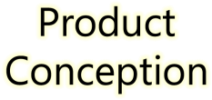
































Microsoft Security Development Lifecycle (SDL)
SDL Book:
http://www.microsoft.com/mspress/books/8753.aspx
Official SDL Web Site: http://www.microsoft.com/sdl

Slide 21


Microsoft Writing Secure Code Book Series
Writing Secure Code,
2nd Edition:
http://www.microsoft.com/mspress/books/5957.aspx
Writing Secure Code for Windows Vista:
http://www.microsoft.com/mspress/books/10723.aspx

Slide 22
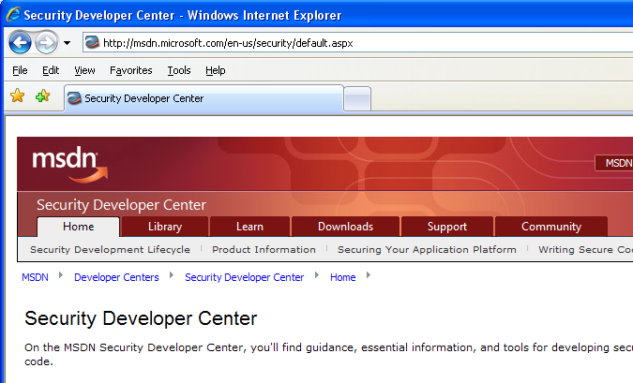

Microsoft Developer Network (MSDN) Security Developer Center
Official Web site: http://msdn.microsoft.com/security

Slide 23
Secure Development Blogs
The Microsoft Security Development Lifecycle (SDL) Blog: http://blogs.msdn.com/sdl
Michael Howard’s Blog: http://blogs.msdn.com/michael_howard

Slide 24
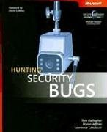
Microsoft Hunting Security Bugs
Hunting Security Bugs:
http://www.microsoft.com/mspress/books/8485.aspx

Slide 25
Additional SDL Training Content
Secure Design Principles
Secure Implementation Principles
Secure Verification Principles
SQL Injection Vulnerabilities
Cross-Site Scripting Vulnerabilities
Buffer Overflow Vulnerabilities

Slide 26
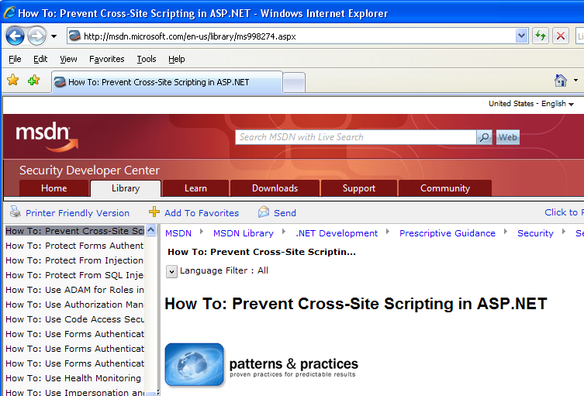
Reducing Exposure to Cross-Site Scripting Attacks using ASP.NET
http://msdn.microsoft.com/en-us/library/ms998274.aspx

